Slide 1

Basic Tables

Slide 2
The <table> Element
The <table> element is a powerful tool for web designers:
Tables allow us to display information in a predictable and uniform fashion on a web page.
Tables are well suited for presenting data that conforms to rows and columns.
Content in table cells is easy to format consistently.
In the past, tables were often used to lay out and organize an entire web page. This was a misuse of the <table> element, which should be used only to present specific information within a page's overall content.

Slide 3
Rows and Columns
Row
Column
This simple table has two columns and three rows.

Slide 4
Building an XHTML Table
<table>
<tr>
<td></td>
<td></td>
</tr>
<tr>
<td></td>
<td></td>
</tr>
<tr>
<td></td>
<td></td>
</tr>
</table>
<table> </table>
Establishes the table on the web page.
<tr> </tr>
Defines a new table row, which spans the available width of the table.
Defines a cell of table data within a row. The <td> cells will evenly share the horizontal space in a row. If there is just one <td> element in a row, it will use the entire width available.
<td> </td>
In this code, we have created a table and defined three table rows, each with two cells of table data (i.e. two columns).
If we loaded this in a browser, nothing would show on the page, as we have only created the structure of the table but haven't yet populated the table with any data.

Slide 5
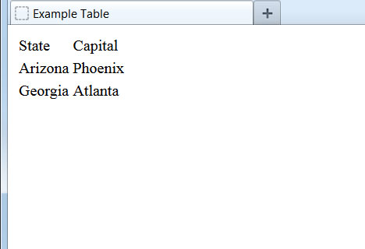
Adding Table Data
<table>
<tr>
<td>State</td>
<td>Capital</td>
</tr>
<tr>
<td>Arizona</td>
<td>Phoenix</td>
</tr>
<tr>
<td>Georgia</td>
<td>Atlanta</td>
</tr>
</table>
Here we have added meaningful data to the table and it is displayed on our web page, though the table is not very visually appealing.

Slide 6
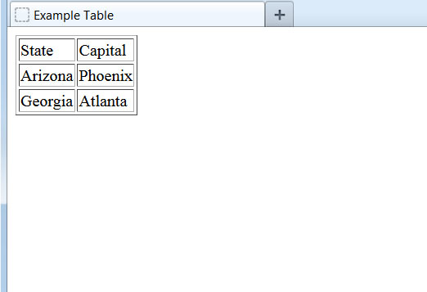
Defining a Border
<table border="1">
<tr>
<td>State</td>
<td>Capital</td>
</tr>
<tr>
<td>Arizona</td>
<td>Phoenix</td>
</tr>
<tr>
<td>Georgia</td>
<td>Atlanta</td>
</tr>
</table>
By adding the border="1" attribute to the table element, browsers will display the table with vertical and horizontal borders around each cell. This makes the table a bit easier to view.

Slide 7
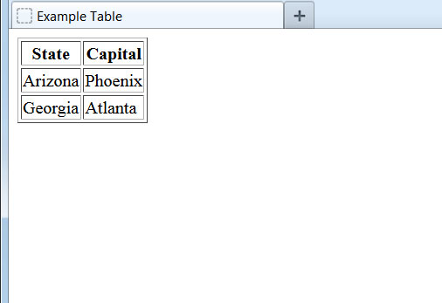
Specifying Table Headers
<table border="1">
<tr>
<th>State</th>
<th>Capital</th>
</tr>
<tr>
<td>Arizona</td>
<td>Phoenix</td>
</tr>
<tr>
<td>Georgia</td>
<td>Atlanta</td>
</tr>
</table>
If the text in our top row is meant to serve as column labels for the data below, we can use the <th> ("table header") element instead of regular <td> elements. This informs the browser to automatically bold and center the text.
Table headers can also be placed down the first column to label the row contents.

Slide 8
Table Styling
Though somewhat improved, this table still lacks visual appeal on the page. In order to fully control how the table appears, we will need something more powerful than XHTML. That something is CSS, which we will get our first look at in the next lesson.

